Slide 1
Electrical
and Electronics science
First year
Computer Science and Engineering
Dr. Shakti Singh
ASSISTANT PROFESSOR
ELECTRCIAL AND INSTRUMENATION
ENGINEERING DEPARTMENT
@shakti.singh@thapar.edu

Slide 2
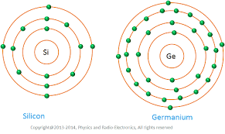
Introduction:
Bohr’s Atomic Model→ Planetary Model →Protons, Neutrons and Electrons.
What is Atomic Number, Energy Levels, Shells.
Valence Electrons
Ionization
Quantum Atomic Model → Wave particle duality, Heisenberg’s Uncertainty Principle.
Ge is more unstable than Si.

Slide 3
What Are Diodes Made Out Of?
Silicon (Si) and Germanium (Ge) are the two most common single elements that are used to make Diodes. A compound that is commonly used is Gallium Arsenide (GaAs), especially in the case of LEDs because of it’s large bandgap.
Silicon and Germanium are both group 4 elements, meaning they have 4 valence electrons. Their structure allows them to grow in a shape called the diamond lattice.
Gallium is a group 3 element while Arsenide is a group 5 element. When put together as a compound, GaAs creates a zincblend lattice structure.
In both the diamond lattice and zincblend lattice, each atom shares its valence electrons with its four closest neighbors. This sharing of electrons is what ultimately allows diodes to be build. When dopants from groups 3 or 5 (in most cases) are added to Si, Ge or GaAs it changes the properties of the material so we are able to make the P- and N-type materials that become the diode.
Si
+4
Si
+4
Si
+4
Si
+4
Si
+4
Si
+4
Si
+4
Si
+4
Si
+4
The diagram above shows the 2D structure of the Si crystal. The light green lines represent the electronic bonds made when the valence electrons are shared. Each Si atom shares one electron with each of its four closest neighbors so that its valence band will have a full 8 electrons.

Slide 4
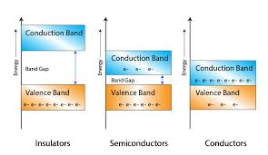
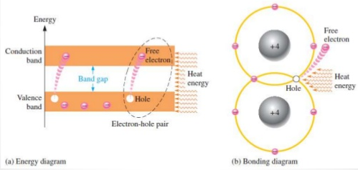
Semiconductor Materials
Conduction current in semiconductors is composed of two parts:
Electron current.
Hole current.

Slide 5
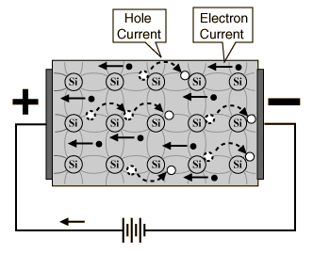
Electron and Hole Current
When a voltage is applied across an intrinsic silicon, the thermally generated free electrons in the conduction band are attracted towards the positive potential of battery.
The movement of free electrons creates electron current.
Another current is through the hole current.
The electrons in the valence band are still attached to the atoms and are not free to move in the crystal as free electrons.
However, a valence electron can move into a nearby hole, leaving a hole on its previous position.
This current produced through movement of valence electrons is hole current.

Slide 6
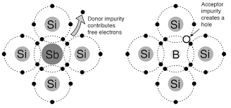
N and P type semiconductors
N-type-Pentavalent impurity (As, P, Bi, Sb)
Impurity is the donor atom.
Extra or free electron contributes to conduction.
Electrons →Majority carriers
Hole → Minority carriers.
P-type-Trivalent impurity (B, In, Ga)
Impurity is the acceptor atom.
Hole generated contributes to conduction.
Holes →Majority carriers
Electrons → Minority carriers.
N type
P type

Slide 7
N-Type Material
N-Type Material:
When extra valence electrons are introduced into a material such as silicon an n-type material is produced. The extra valence electrons are introduced by putting impurities or dopants into the silicon. The dopants used to create an n-type material are Group V elements. The most commonly used dopants from Group V are arsenic, antimony and phosphorus.
The 2D diagram to the left shows the extra electron that will be present when a Group V dopant is introduced to a material such as silicon. This extra electron is very mobile.
+4
+4
+4
+4
+5
+4
+4
+4
+4

Slide 8
P-Type Material
P-Type Material:
P-type material is produced when the dopant that is introduced is from Group III. Group III elements have only 3 valence electrons and therefore there is an electron missing. This creates a hole (h+), or a positive charge that can move around in the material. Commonly used Group III dopants are aluminum, boron, and gallium.
The 2D diagram to the left shows the hole that will be present when a Group III dopant is introduced to a material such as silicon. This hole is quite mobile in the same way the extra electron is mobile in a n-type material.
+4
+4
+4
+4
+3
+4
+4
+4
+4

